Slide 1
CS 4530: Fundamentals of Software Engineering
Lesson 7.1: Teams
Adeel Bhutta and Mitch Wand
Khoury College of Computer Sciences
© 2024 Released under the CC BY-SA license

Slide 2
Learning Goals for this Lesson
At the end of this lesson, you should be able to
  Explain key advantages of working in a team and sharing information with your team
  Describe the HRT pillars of social interaction
  Understand why small teams are effective for agile processes
  Apply root-cause analysis to construct a blameless post-mortem of a team project
Notes:
<read slide>

Slide 3
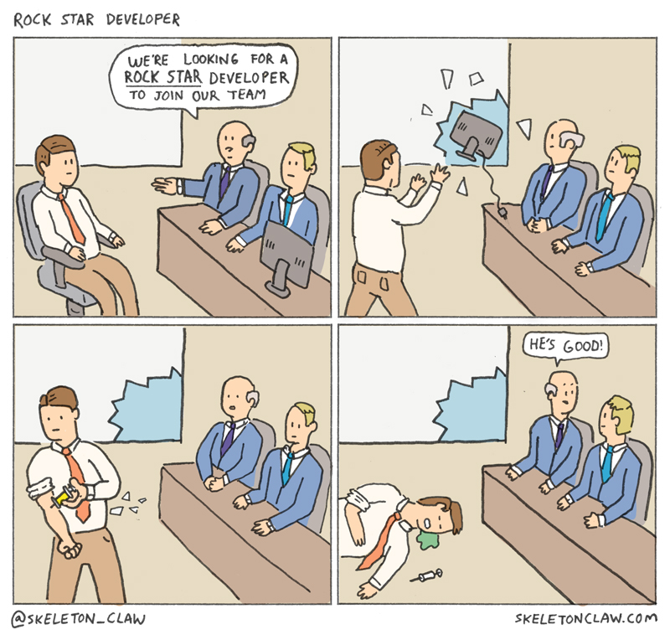
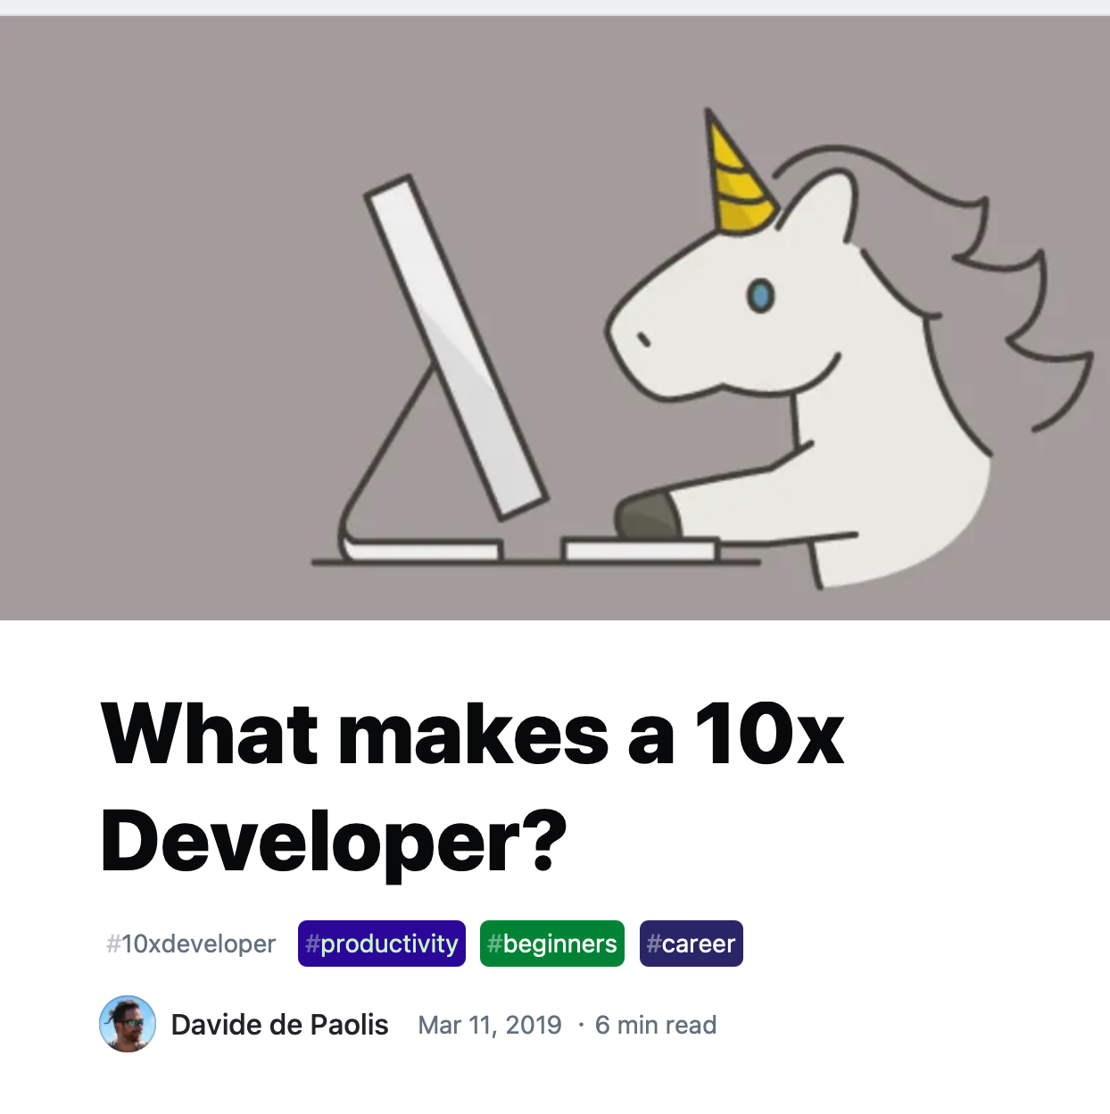
Why Teams? “The 10x Engineer”
Notes:
Creating any non-trivial project requires a strong team. This might seem counter-intuitive to some, perhaps given an instinct to find and worship idols. Who are our SE idols? Linus Torvalds, Guido Van Rossum, Bill Gates? Weren’t each of these individuals responsible for building something big?
Linus didn’t write linux alone: wrote beginnings of PoC Unix-like kernel, show to mailing list, form community, lead people and coordinate work. Not result of his PoC Unix-like kernel, but result of community. Also: what about Unix? Not just Ken Thompson + Dennis Ritchie, but big group at Bell Labs,
Guido Van Rossum didn’t personally create Python: he wrote first version sure (in 1991!), but hundreds of others contributed to later versions, made it what it is now (not to mention package eco-system… num-py!!)
Steve Jobs led a team that built the Mac. Bill Gates might have written a BASIC interpreter, but is probably better known for building an enormous company around MS-DOS
Genius Myth is our tendency to ascribe success of a team to a single person or its leader. Key is that we are able to form a team and collaborate, sharing knowledge.
“None of us is a smart as all of us”
[potential discussion question: what kinds of qualities would you want in your team members?]

Slide 4
Why Teams? Software Engineering Draws on Many Skills
Nobody is an expert in everything:
  Product management
  Project management
  System-level design and architecture
  Unit-level design
  Development
  Operations
  Maintenance
Notes:
Once you get past the myth that someone can singlehandedly make a huge project like Linux, you realize pretty quickly that there are a lot of specific skills that different individuals might specialize in. <read slide>

Slide 5

Why Teams? The Bus Factor
Even if one person can own all of a project, they shouldn’t be relied to
Notes:
In the context of teams and team performance, one important metric to consider is the bus factor: which is to say, how many members of your team are entirely irreplaceable, the sole holders of particular, specialized knowledge?
If your team can only operate because of one developer who knows in detail how your system works (and this is not documented anywhere), if that developer “gets on a bus” (and doesn’t come back), can your team recover? Effective teams formalize this important knowledge, ensuring resiliency in the event that a team member leaves the group for a variety of reasons (be it to get a new job, or simply moving based on personal constraints)
(Build) GitHub has recently started to track projects that are popular, but have a bus factor of 1 - projects with a single maintainer, creating a notification and using this language of “inviting a successor” in case “you are unable to access your account” – but being locked out of your account is just another way that this problem can present. You really do not want a bus factor of one.

Slide 6
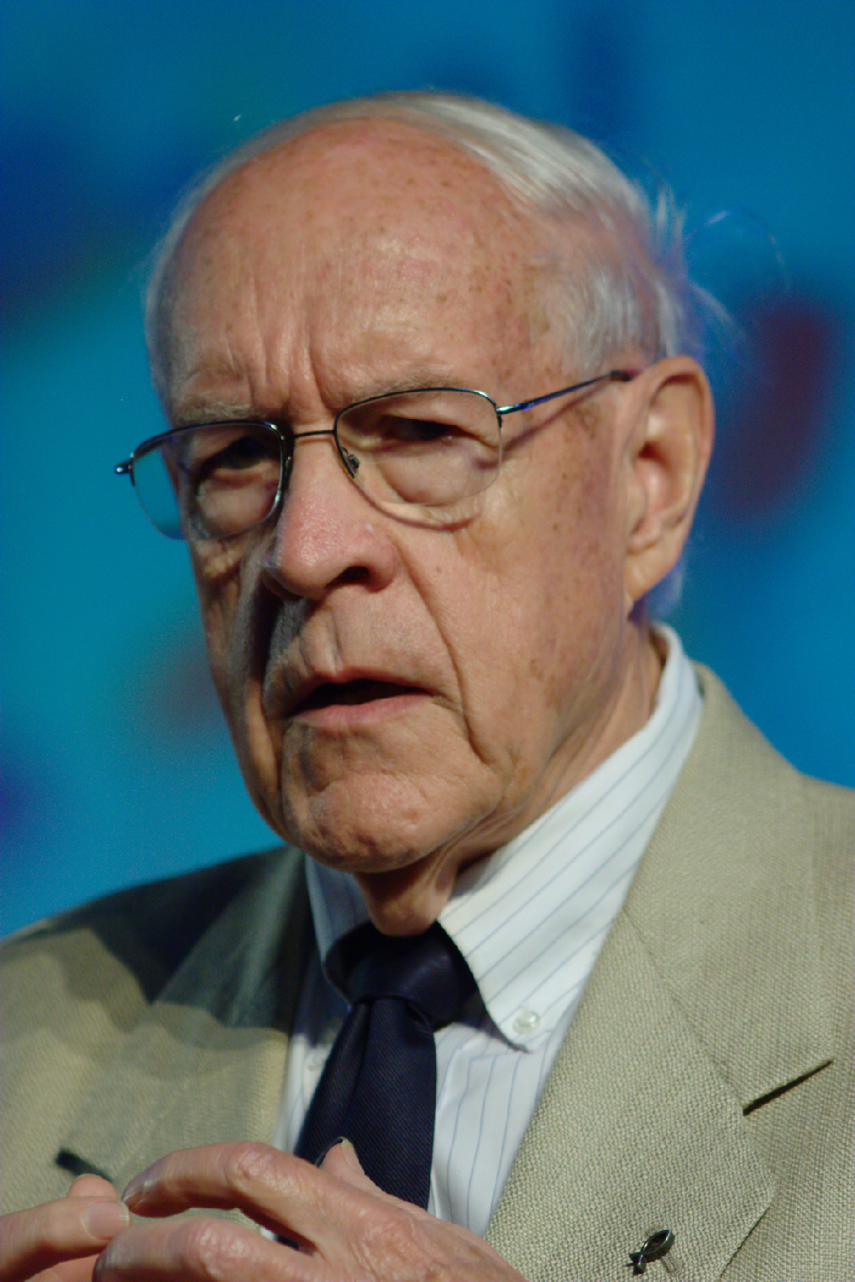
Teams are hard: Brooks’ Law
“Adding manpower to a late software project makes it later”
Fred Brooks, 1975
Notes:
In the 70’s, a prominent software engineer named Fred Brooks analyzed software construction failures, coining Brooks’ Law: “Adding manpower to a late software project makes it later.” He talked a lot about the problems that software engineers faced at the time.
The core thesis behind his book “The mythical man month” is that it’s a myth to estimate software construction in terms of person-months. This is because complex projects can never be perfectly partitioned into discrete chunks that can be worked on independently.
Hence, when adding more team members, you also increase the amount of communication necessary across team members, making your overall development speed slower, not faster.
If you’ve been following along in the Software Engineering @ Google book this semester, you have likely found that one of the recurring themes in THAT book is to design processes that scale sub-linearly with the size of your team or the scale of your software: that is, to get around Brooks’ law.

Slide 7
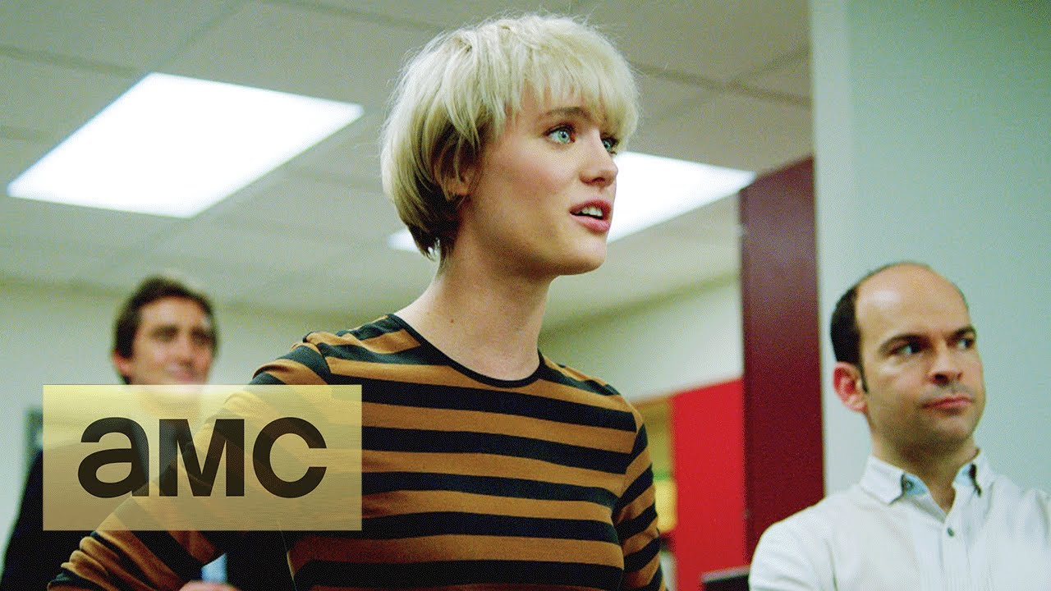
Brooks’ Law: Cultural References
AMC’s Halt and Catch Fire, Season 1 Episode 5
Notes:
Halt and Catch Fire… building a clean-room implementation of IBM PC bios. Set in a silicon praire (DFW texas - think texas instruments). Company is on a big deadline to re-implement entire IBM PC bios *very* fast, funded by texas oil money. They bring in some software manager who then hires a huge new team of developers, and project keeps slipping. Our hero, Cameron Howe (Mackenzie Davis) confronts the executive Joe MacMillan (Lee Pace).
Play until :24 “How do you even know which programmers to keep?”

Slide 8
What goes wrong with teams in software development?
How do you structure teams effectively?
How do you encourage teams to share knowledge and collaborate?
How do you encourage team-members to treat each other well?
How do you respond to failures?
Notes:
[Ask students to share experiences good and bad of working in teams before doing animation]
(Read slide of common team issues)
Our goal with this lesson is to share some common strategies to address these problems. Some of these lessons will be things that you can operationalize: how to be a better team player. Others will be things that you won’t be able to operationalize directly. We do not expect many of you will graduate and immediately enter positions where you will be making decisions about how to structure and lead a team. But, it is quite likely that you will be subject to someone else making those decisions. Through this lesson, we hope to provide you with a framework for understanding how effective teams are organized. One of the core agile principles that we’ve been talking about this week is: how to connect what we are doing to the ultimate value that we are delivering to our customers through our software. By understanding why team processes are setup like they are, hopefully you can understand better the value that those processes provide – and maybe you can even help your manager reflect on and improve their existing processes.

Slide 9

How do we structure teams efficiently?
Examining Brooks’ Law: “Adding manpower to a late software project makes it later”
How many communication links are needed to finish a task?
Self-organizing teams have proven more effective
Notes:
The first question/challenge that we will look at is: how to structure teams efficiently?
Agile methodology provides a rationale to Brooks’ law, which helps to consider ways to address this shortcoming.
If you take a small team size of, say, six. That’s 15 links between everyone.
Double that group for a team of 12. That shoots up to 66 links.
A small business of 50 people has an incredible 1,225 links to manage.
The cost of coordinating, communicating, and relating with each other snowballs to such a degree that it lowers individual and team productivity.
This is the rationale for Brooks’ law.
Hence, our first lesson for how to structure teams effectively is: keep them small.

Slide 10
Facebook originally organized teams by platform
If you work on the android teams, you work on putting all of the apps on android
Desktop/Web
Android
iOS
Engineering Teams
Group messages
Group messages
Chat
Upcoming Events
Birthdays
Photo Albums
Photo Picker
Group messages
Chat
Upcoming Events
Birthdays
Photo Albums
Photo Picker
Group messages
Group messages
Chat
Chat
Messages
Chat
Upcoming Events
Upcoming Events
Events
Upcoming Events
Birthdays
Birthdays
Photos
Birthdays
Photo Albums
Photo Albums
Android
Photo Albums
Photo Picker
Photo Picker
Photo Picker
iOS
Product Experts
Platform Experts
https://www.youtube.com/watch?v=Nffzkkdq7GM
Notes:
Here’s an example that shows loosely how Facebook structured their mobile development pre-2014. It might feel like a very long time ago, but Facebook existed before smart phones. Facebook’s internal organization for the desktop/web application was centered around product teams: some folks worked on messages, others on events, others on photos. Within these big teams, there are also, of course smaller teams with narrower focus, but at a high level, this is the story – teams focused on specific product value.
<Click>
When it came time to start to develop mobile apps, Facebook built out entirely new teams, who were “platform experts”. Instead of each of the product teams developing their product for these new platforms, there were new “platform teams” created who took the existing products, and managed their development in these new platforms.
Brainstorm: What is good about this? What is bad about this?
Good things:
New technologies are maybe hard to adopt; lets you concentrate that learning in one place
Bad things:
Lack of clear responsibilitiy for whose fault a bug is
Hard to keep expectations from users that each platform has same features
Communication gets wasted
This is discussed starting at ~18 mins in https://www.youtube.com/watch?v=Nffzkkdq7GM

Slide 11
But they eventually switched to "product" teams…
If you are in the chat group, you work on the chat feature in all platforms
Desktop/Web
Android
iOS
Engineering Teams
Group messages
Group messages
Group messages
Group messages
Chat
Upcoming Events
Birthdays
Photo Albums
Photo Picker
Group messages
Chat
Upcoming Events
Birthdays
Photo Albums
Photo Picker
Messages
Chat
Chat
Chat
Events
Upcoming Events
Upcoming Events
Upcoming Events
Photos
Birthdays
Birthdays
Birthdays
Photo Albums
Photo Albums
Photo Albums
Android
Photo Picker
Photo Picker
Photo Picker
iOS
Product Experts
https://www.youtube.com/watch?v=Nffzkkdq7GM
Notes:
Here’s what they moved to. Just product experts. Quite a bit of struggle organizationally to get a home for everyone, and to get everyone on the same page. But, again, why? Because now if you work on the chat group, you work on the chat group for all platforms. There is less cloudiness of who is responsible for what. The features on all platforms are built by the people who know the features, rather than the people who know the platforms.
Same argument applies to why we shouldn’t have “backend” team and “frontend” team. This is why “full-stack developer” is what companies want to hire. We hope you will finish this course with the skills to be able to put yourself on the job market as a full stack developer!

Slide 12
Good Teams create Intentional Opportunities for Knowledge Sharing
Ideally, scale linearly (or sub linearly) with org growth
What kind of approaches do you think could help improve knowledge sharing?
  "Two Pizza" Teams
  Pair Programming
  Code Reviews
  Multiple sharing channels
Notes:
A strong and effective team relies on effective knowledge sharing. Recall Brooks’ law - adding more manpower to a late project makes it later - this was because for each team member that you added, that new team member would need to communicate and coordinate with multiple existing team members, hence reducing the productivity of the rest of your team. Instead, effective teams focus on the kind of knowledge sharing that grows linearly or even better, sub-linearly with the size of your team, like Q&A platforms (such as stack overflow), mailing lists, internal presentations, and documentation
Discuss also: what kinds of knowledge should we be sharing? Sharing and establishing best practices, community norms, etc.

Slide 13

“Two-Pizza” Teams make knowledge sharing easier
Q: How many people on a team?
A: “No more than you could feed with two pizzas”
Rationale:
Decrease communication burdens
Focus conversations to relevant topics
Notes:
A common way to refer to these “small” teams is to think about it in terms of how big of a meeting you will have when you bring your whole team together, usually no more than 9 people.
Imagine having a Scrum meeting with 6 team members. In your 15 minutes, each team member gets about 2 minutes to share what they did since the last meeting, what they are . You can have a meaningful interaction, where problems are shared and solutions identified.
Now imagine that same meeting, but with a team of 20. In your 15 minutes, each team member gets less than a minute to share the same. How can you effectively have the same meaningful interaction?
Oh, just make the meeting longer, they say. Make it 40 minutes – then everyone still gets 2 minutes! But now, in addition to using up much more of each person’s day, you risk losing focus: are all 20 team members really going to be able to make an effective contribution to help each other on their tasks?
So, two pizza teams

Slide 14
Pair Programming is a Knowledge Sharing Activity
Two programmers work together at one computer, one “driving,” one “navigating”
Survey of professional programmers (2001):
  90% “enjoyed collaborative programming more than solo programming”
  95% were “more confident in their solutions” when pair programmed
  Provides long-term benefits: reduces defects by 15%, code size by 15%
  Increases costs by 15% to 100% compared to single developer on the task
Cockburn and Williams. The Costs and Benefits of Pair Programming, (In: Extreme Programming Explained 2001)
Notes:
Pair programming is another knowledge sharing activity on the 1:1 level, which you might have already heard about. <read slide>

Slide 15
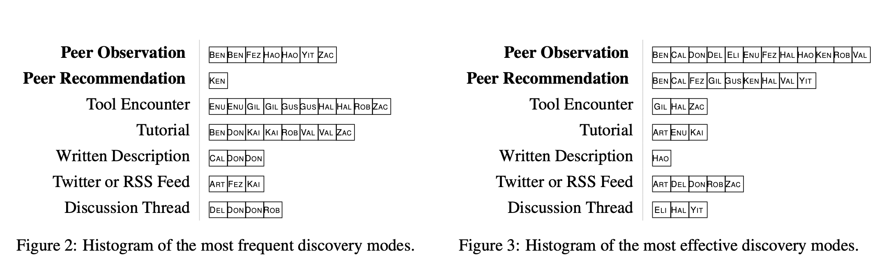
Pair Programming Improves Tool Diffusion
Peer observation and recommendation shown to be more effective at discovering new tools than other knowledge sharing approaches
Examples: Hot keys, especially for CLI; IDE tricks
Most common in 2011 survey: “Open Type” feature in Eclipse, developer tools in web browser
“Peer interaction effectively, yet infrequently, enables programmers to discover new tools”, Emerson Murphy-Hill & Gail C. Murphy, CSCW 2011
Notes:
Pair programming has many benefits BESIDES helping you learn about the code – it’s a great way to learn about TOOLS!
<read slide>
<Looking at the figures – show the most frequent and effective discovery modes. psuedonyms of names are alphabetically ascending years of experience (Ben is 3 yrs, Zac is 32 yrs)>

Slide 16
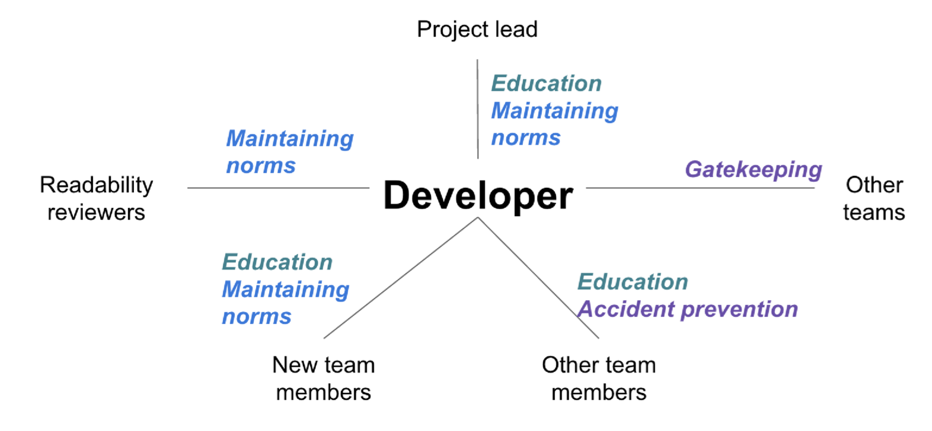
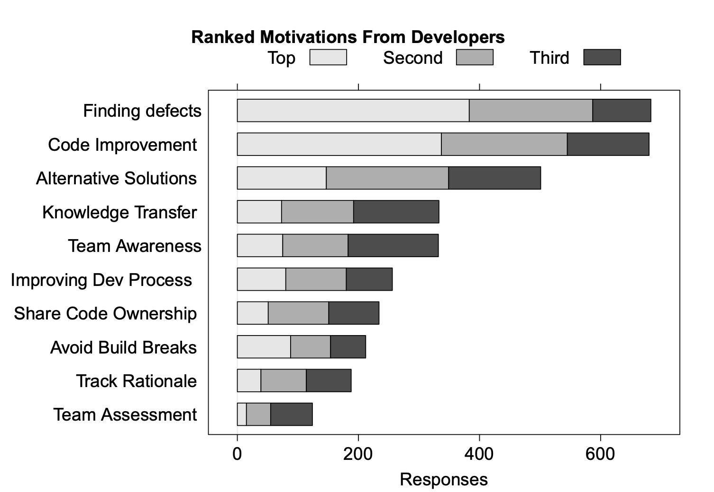
Code Review is a Knowledge Sharing Opportunity
“Modern Code Review: A Case Study at Google”, Sadowski et al, ICSE 2018
“Expectations, Outcomes, and Challenges of Modern Code Review”, Bacchelli & Bird, ICSE 2013
Notes:
There are, of course, many other approaches to improve collaboration within a team.
In addition to assuring quality, code review can help with knowledge transfer.
The figure on the left is from a google-internal study in 2018 examining the kinds of knowledge that different stakeholders could gain from the practice of code review. In addition to maintaining norms (perhaps different sets of norms for different reviewers – consider readability reviewers vs project lead), code review can be useful for education.

Slide 17
Scaling Communication linearly requires multiple channels
Knowledge sharing needs to scale linearly (or sub linearly) with org growth:
  Mentorship
  Q&A
  Mailing lists
  Tech talks
  Documentation
Notes:
So, A strong and effective team relies on effective knowledge sharing.
Recall Brooks’ law - adding more manpower to a late project makes it later - this was because for each team member that you added, that new team member would need to communicate and coordinate with multiple existing team members, hence reducing the productivity of the rest of your team.
What’s the overhead of code review and pair programming? Does it grow linearly or sub-linearly?
Instead, effective teams focus on the kind of knowledge sharing that grows linearly or even better, sub-linearly with the size of your team, like Q&A platforms (such as stack overflow), mailing lists, internal presentations, and documentation.

Slide 18

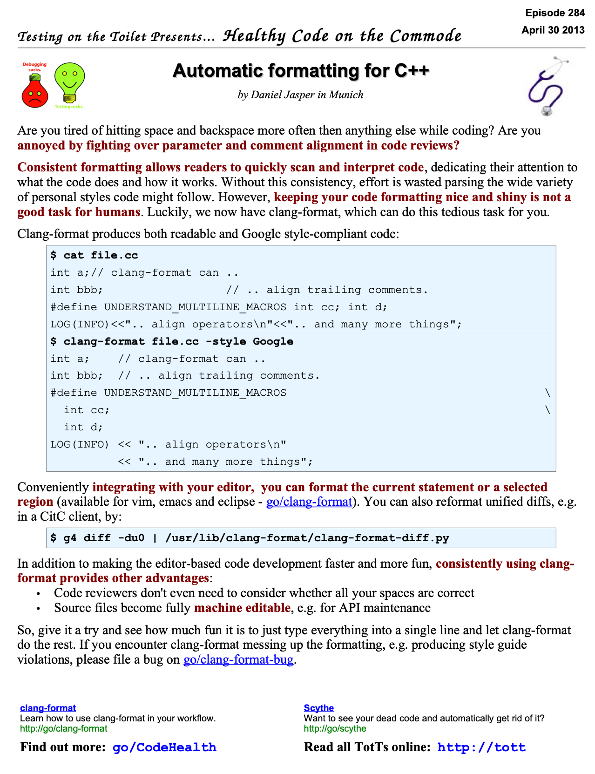
Standardize and Document Best Practices
Wikis, blogs, tech talks scale-out more than 1:1 mentoring
Rule of thumb: once you have explained something to more than two people, maybe you should write a blog post
Effective organizations cultivate programs to organically collect and share knowledge and best practices
Example: Google “Testing on the Toilet” (c 2006)
Notes:
No matter how your organization does it, it is crucial to standardize and document best practices, because wikis, blogs, tech talks etc scale out much better than 1:1 mentoring.
<read slide. They literally posted these flyers on the inside of toilet stall doors and in front of urinals>

Slide 19
Do Developers Discover New Tools In The Toilet?
Researchers studied the efficacy of the flyer
Exposure to the flyers significantly increased and sustained adoption of the tools advertised on them
Provided more “memorability” compared to social media (location + curation)
Limitations
  Not evenly posted and updated globally (volunteer effort; minority tax)
  Editorial curation is difficult
  Not all episodes are relevant to all teams
“Do Developers Disocver New Tools on The Toilet?”, Emerson Murphy-Hill et al, ICSE 2019

Slide 20
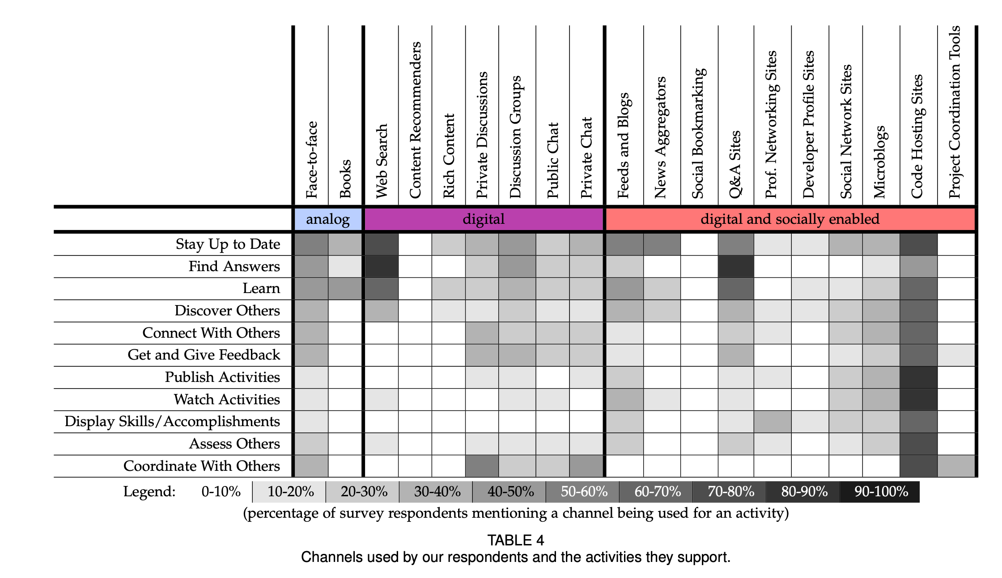
Communicate Development Activities with Different Channels
On average, developers use eleven channels to stay up-to-date on development activities
“How Social and Communication Channels Shape and Challenge a Participatory Culture in Software Development” Storey et al, TSE 2015
Notes:
Aside from pair programing and flyers in the toilet, there are, of course, quite a few other channels in which you might stay up-to-date with development activities.
This 2015 study examined the different social and communication channels that developers used. They considered a wide range of channels – analog (like face-to-face and books), digital (like web search, chat) and social+digital (like blogs, q&a sites, etc).
The dark cells indicate the percentage of survey respondents that reported using a channel for an activity. <discuss findings, surprises, etc – interesting to note that ‘code hosting sites’ have become dominant for really all things, as platforms like github continuously add new features>
Not on the slide: What were the main challenges that developers face when using social media to communicate? privacy, over-whelming amounts of content, and it’s distracting (shocker!)

Slide 21
How do you encourage team members to treat each other well?
Notes:
Can brainstorm from students, or just use this as a transition
A related question could be, what are some of the useful traits for successful software engineers?
Here is a list:
Sense of individual responsibility
Acutely aware of the needs of team members and stakeholders
Brutally honest about design flaws and offers constructive criticism
Resilient under pressure
Heightened sense of fairness
Attention to detail
Pragmatic

Slide 22
Three Pillars of Social Skills
Pillar 1: Humility: You are not the center of the universe (nor is your code!). You’re neither omniscient nor infallible. You’re open to self-improvement.
Pillar 2: Respect: You genuinely care about others you work with. You treat them kindly and appreciate their abilities and accomplishments.
Pillar 3: Trust: You believe others are competent and will do the right thing, and you’re OK with letting them drive when appropriate.
From “Debugging Teams” by Ben Collins-Sussman and Brian Fitzpatrick
Notes:
If we agree that there are no 10x engineers, and that we need to form effective teams in order to scale up our software engineering processes, then perhaps we can agree on some ground-rules for working productively with our team mates. These three pillars are taken from the book “Debugging Teams” - the authors of this book are long-time software team leads at Google.
Both trace almost every social conflict that they have witnessed in their orgs back to a lack of one of these three traits.
This lens (HRT, pronounced “heart”) is useful for evaluating all kinds of personal conflicts. We work with others, and will be most effective when we can create long-lasting relationships with our colleagues who will be able to help us out later when we need. For example: nobody wants to work with someone who consistently behaves like they are the smartest person in the room. Give and receive constructive criticism.
(some notes on pillars)
Humility – it’s fun to be the most knowledgeable person in the room, and mentoring others can be rewarding. It is easy to get addicted to being the lead on projects – you start out as the person who knows the most about something. But, eventually you will need to change directions and get exposed to new things. Once you reach a local maximum on your team, you stop learning. And then you get bored. Put yourself outside of your comfort zone, and be open to trying new things that you are less confident about. Be willing to show some weakness.
Respect – how do you criticize and give feedback on someone’s work while recognizing their strengths?
Trust – Might feel hard at first if you have been burned many times by team-mates who you delegated something to and who were, simply put, incompetent. Requires a two-way commitment. Trust that you can delegate something to someone else, and that they will have the respect and humility to ask for help if needed.

Slide 23
HRT Example: Code Review
This is personal
Is this really that black and white?
“Man, you totally got the control flow wrong on that method there. You should be using the standard foobar code pattern like everyone else”
Are we demanding a specific change?
Everyone else does it right,
therefore you are stupid
From “Debugging Teams” by Ben Collins-Sussman and Brian Fitzpatrick
Notes:
Read code review comment. Ask students how they would feel if they got this feedback. Ask them why they would feel that way.
Then do the builds and talk through each part that is problematic, and how it violates HRT
“You” – Violates respect. This is making it personal. Show respect for others.
“wrong” – Violates humility. This assumes that there is a clear “wrong” here. Is it wrong, or is there instead something else we could say to describe what we think is wrng?
“using the standard…” – Violates humility again. Are we demanding a SPECIFIC changes? Not only is the existing way wrong, but there is a CLEAR right way? How often does that really come up in software development?
“everyone else” – makes clear that the reviewer doesn’t trust the person who wrote the code. How can we move forward with out trust?
This is not a productive comment because the response is going to be overly emotional, coming from someone who was put on the defense
Brainstorm: "If you had a bad team experience in the past, can you explain it in terms of these three pillars?”

Slide 24
HRT Example: Code Review
“Man, you totally got the control flow wrong on that method there. You should be using the standard foobar code pattern like everyone else”
“Hmm, I’m confused by the control flow in this section here. I wonder if the foobar code pattern might make this clearer and easier to maintain?
Humility! This is about me, not you
From “Debugging Teams” by Ben Collins-Sussman and Brian Fitzpatrick
Notes:
Read the new comment. Ask students what they think about this? How is it better?
(build to highlight the humility aspect)
The suggestion overall is: Don’t outright say that the other person is wrong: you are just having trouble understanding it. Could be your fault or theirs. Not demanding any specific change, but suggest something that might help improve. No discussion of the author’s value or coding skills

Slide 25

Responding to Failures
In software, in humans, and in processes.
How do we learn:
What went well?
What went wrong?
Where we got lucky?
How do we prevent it from happening again?
Notes:
One of the most exciting parts of working on a big project with a team is that you have the chance to make something far bigger than you could have on your own.
Unfortunately, a corollary to that is that it’s also possible to have a larger-scale failure than you could have made on your own.
It’s extremely likely that you will, if you have not yet, experienced a problem on your team. Perhaps you had a significant software failure (like a bug being released into production, or someone delaying the development process), a human failure (like interpersonal issues with a teammate) or a process failure (like a testing system that doesn’t actually test what you thought it would)
Putting out fires is a topic for another lecture. The part that is relevant for our team discussion, is the most important thing for the future:
…how to learn from mistakes. How do you learn from mistakes? We usually want to learn what went well (what worked?), what went wrong (obviously the house caught on fire, but why?), where we got lucky (the fire department was already close!), and how we can prevent this from happening again.
The process of reflecting on and learning from these mistakes can be formalized into a “post mortem” review

Slide 26
How Not to Respond to Failures
Some engineer contributes to failure or incident
Engineer is punished/shamed/blamed/retrained
Engineers as a whole become silent on details to management to avoid being scapegoated
Management becomes less informed about what actually is happening, do not actually find/fix root causes of incidents
Process repeats, amplifying every time
Notes:
It’s extremely important to consider *how* to conduct this post-mortem. In a naive approach (which we might call name, blame and shame), we might not be able to actually learn from this incident…(read from slide, relating personal experiences if you want, or asking students if they have seen this, etc)

Slide 27
Blameless Post-Mortems
What actions did you take at the time?
What effects did you observe at the time?
What were the expectations that you had?
What assumptions did you make?
What is your understanding of the timeline of events as they occurred?
Notes:
In order to figure out what went well, what didn’t, and where we were lucky, we need answers to all of these questions. How can we get true answers if there is fear of punishment or retribution? Engineer might misrepresent the actions that they took to make themselves look better, or play dumb about the effects that they saw

Slide 28
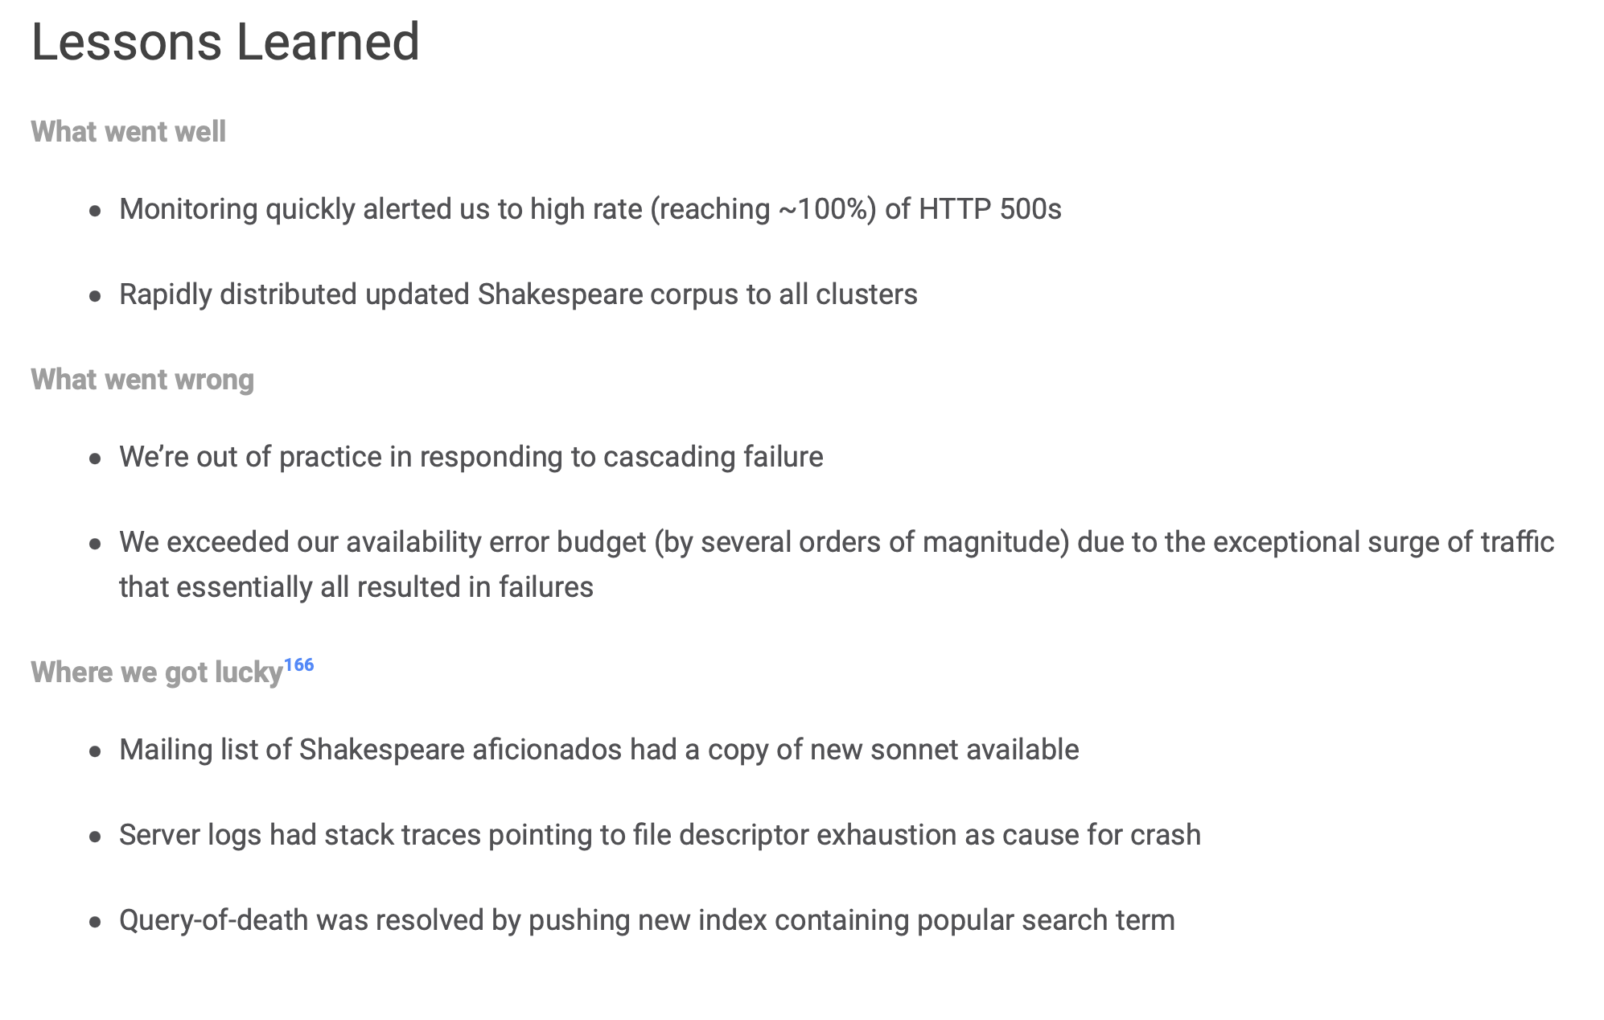
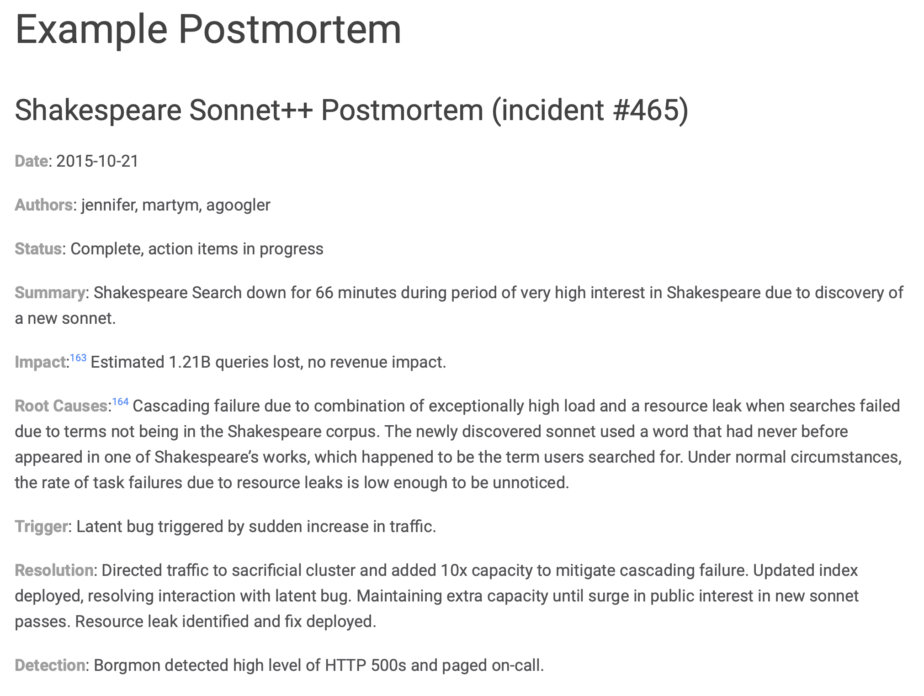
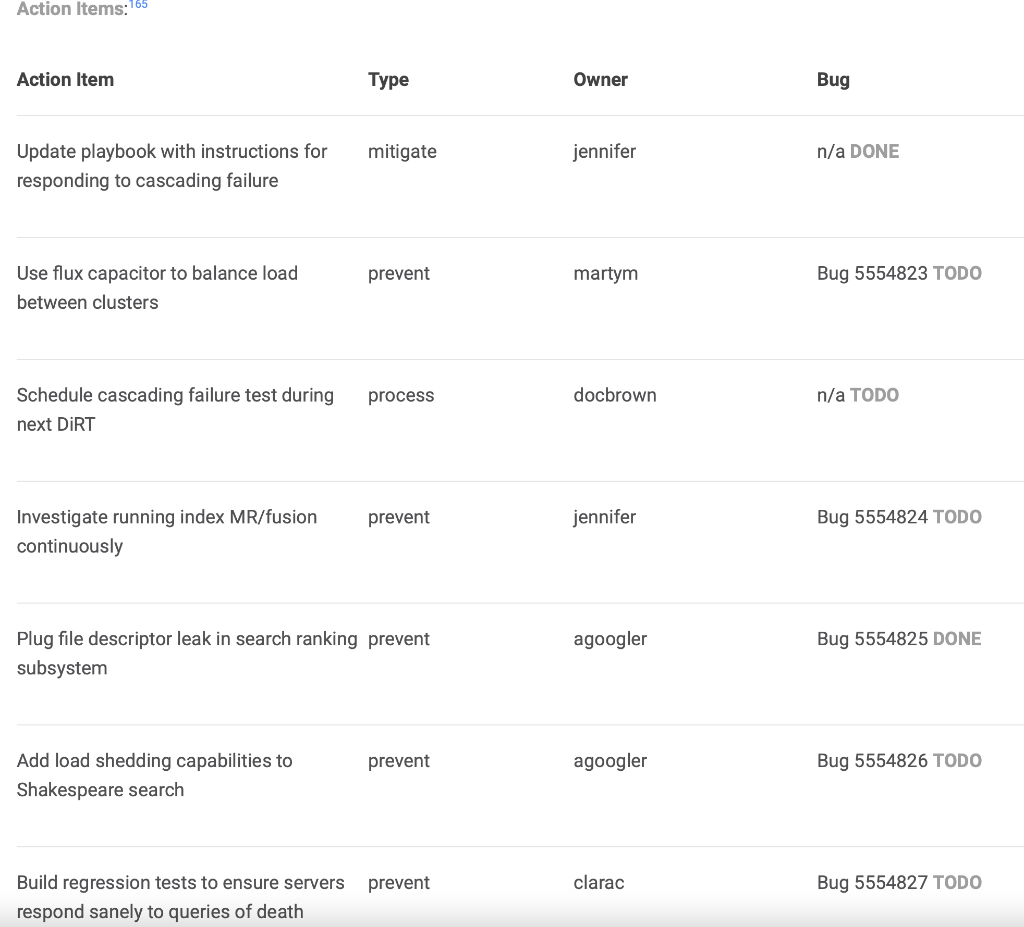
Google’s Example Postmortem
Notes:
We’ll look at an example of a post-mortem. This example is fictitious, but the outage described, reason for the outage, and the postmortem itself are representative of real failures and post-mortem inside of Google. The example is situated in Google’s Shakespeare search engine - and the scenario describes an outage that occurred due to a sudden spike in interest in the service, combined with a resource leak that hadn’t been noticed when the service wasn’t under high load. An on-call engineer was alerted, but the slow resolution still resulted in 66 minutes of downtime. Given a service that might aim for 99.99% availability, this 66 minutes exceeds your downtime budget for the entire year. So, this is actually a very bad thing. The idea behind the post-mortem process is to learn from this, so that 1: the same service won’t go down again this year, and 2: other services that experience similar issues will be able to avoid similar problems
In this postmortem document, we can note detailed root cause: high load AND resource leak, AND note that failure response was not quite right.
(Click to build in the list of action items.)
Action items include approaches to prevent similar failures in future (by making system more fault tolerant + scalable), in addition to fixing the underlying cause of the resource leak, AND updating documentation to improve response times to cascading failures in future. This shows the steps that were taken to resolve the problem, AND how to prevent it from occurring again
(Click to build in lessons leanred)
No matter who introduced the resource leak, who set it up wrong, and whose fault in particular this was: most important is lessons learned. The lessons learned are organized between “what went well”, ”what went wrong”, and “where we got lucky”. Even though there was a failure, it WAS noticed quickly, and once a fix was identified, it was fixed fast. We see clearly how it could have gone better, had there been more expertise in resolving these kinds of failures. Nonetheless, we “got lucky” in that there were a few key pointers that helped to diagnose and fix the situation.

Slide 29

Blameless Post-Mortems: Real World Example
Notes:
Here’s a screenshot of a post-mortem conducted by Amazon from this past December that took down foundational aspects of Amazon’s northern virginia data center, which led to degraded performance (or, put more plainly, a huge outage) of most amazon cloud services, and correspondingly, many services that rely on AWS. Public post-mortems like this are helpful for improving customer trust: customers want to know that Amazon learned from this situation, so that it would be unlikely to re-occur. (Arrested development narrator voice: It would still be likely to re-occur).

Slide 30
Conducting Postmortems
Apply this technique after any event you would like to avoid in the future
Apply this to technical and non-technical events
Focus on improvement, resilience, and collaboration: what could any of the actors have done better?
Google’s generic postmortem template
Notes:
You can and should use this approach to reflect on any event that you would like to avoid in the future. Remember the pillars of HRT, and conduct a blameless post-mortem to learn from what happened, acknowledge what went wrong, but avoid pinning any particular blame to an individual. In fact, you might find that it’s useful to visibly reward people for doing the right thing, to encourage participation in this process and allow your entire organization to improve from that failure. For example, even if you were the one who took down Amazon’s S3 service for the entire east coast of the US for a few hours, maybe there was still something to learn - in Amazon’s postmortem of that incident, they describe the process changes that were made to prevent similar outages from happening in the future. It’s hard to change the past, but, we can always seek to improve.
We hope that you keep these lessons in mind throughout the semester, as your team project starts up.

Slide 31
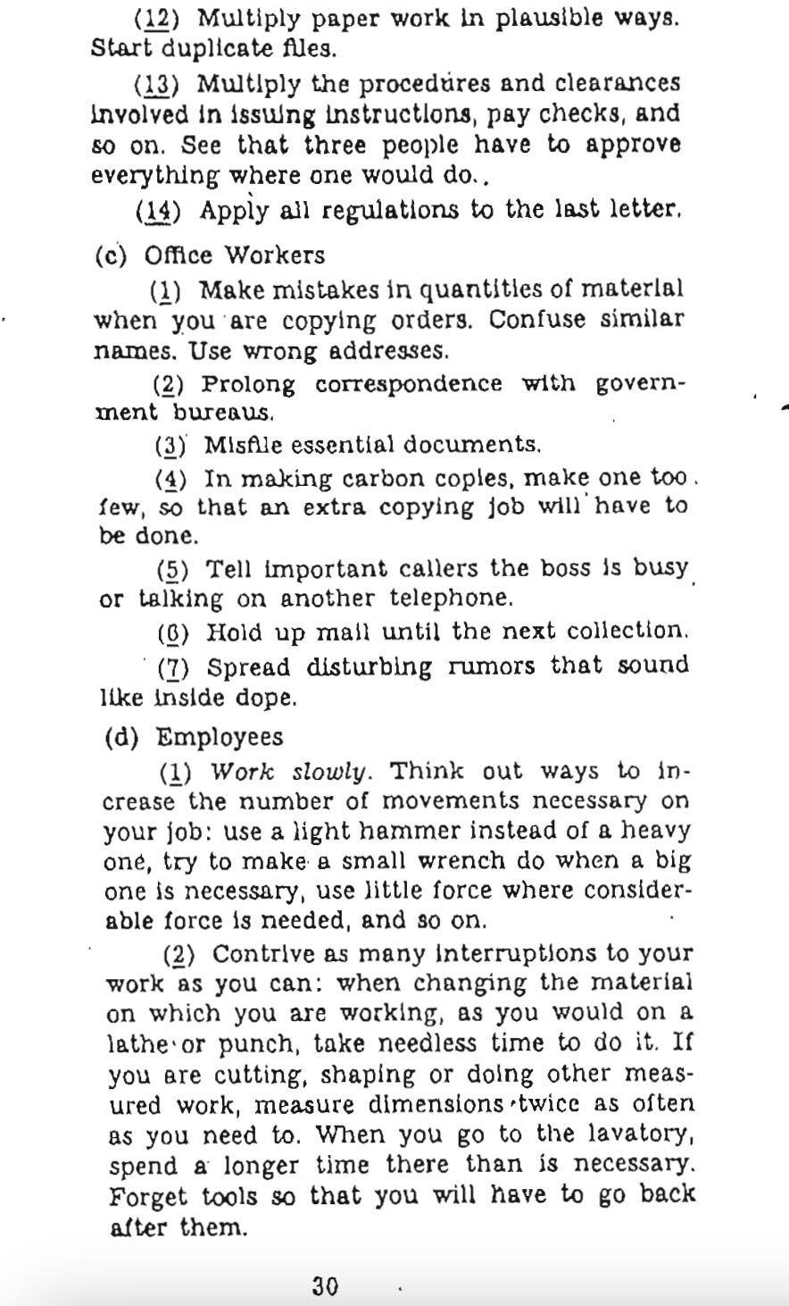

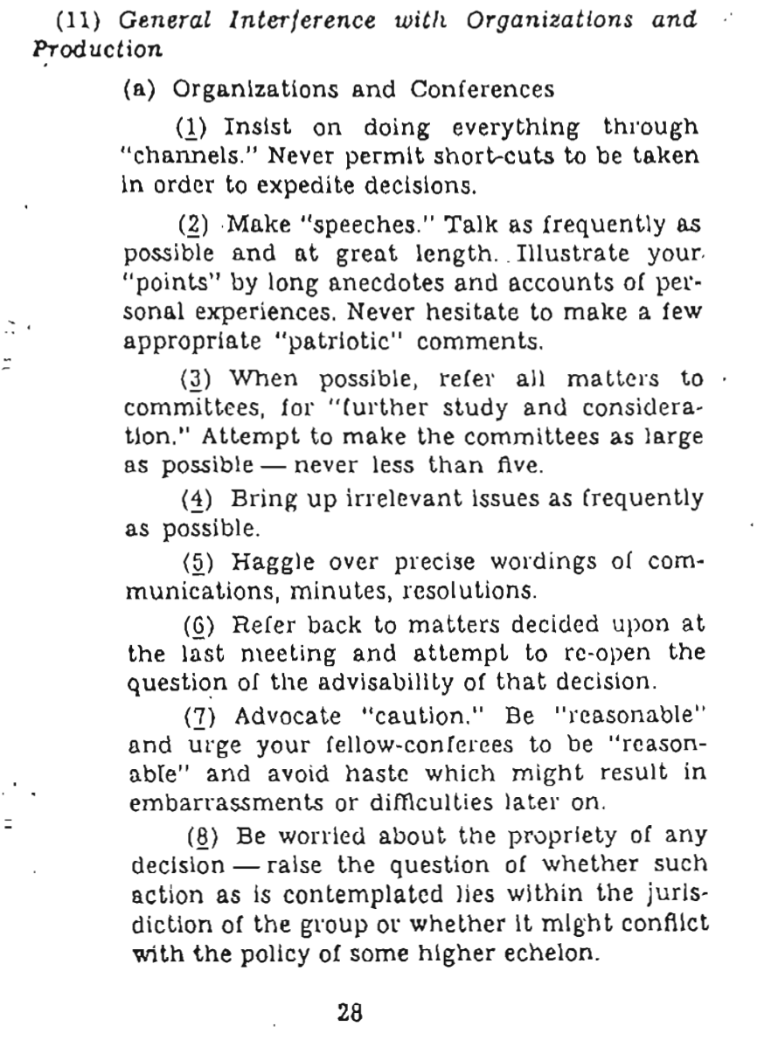
Anti-Patterns for Teams
(CIA Sabotage Guide c 1944)

Slide 32
Learning Goals for this Lesson
At the end of this lesson, you should be able to
  Explain key advantages of working in a team and sharing information with your team
  Describe the HRT pillars of social interaction
  Understand why small teams are effective for agile processes
  Apply root-cause analysis to construct a blameless post-mortem of a team project
Notes:
<read slide>

